Slide 1
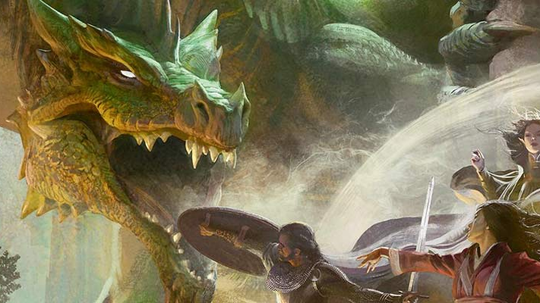
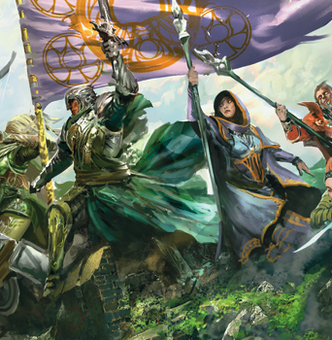

Adventure Day
Created By: Ryan Solnik
Advised By: Dr. Robert Adams

Slide 2

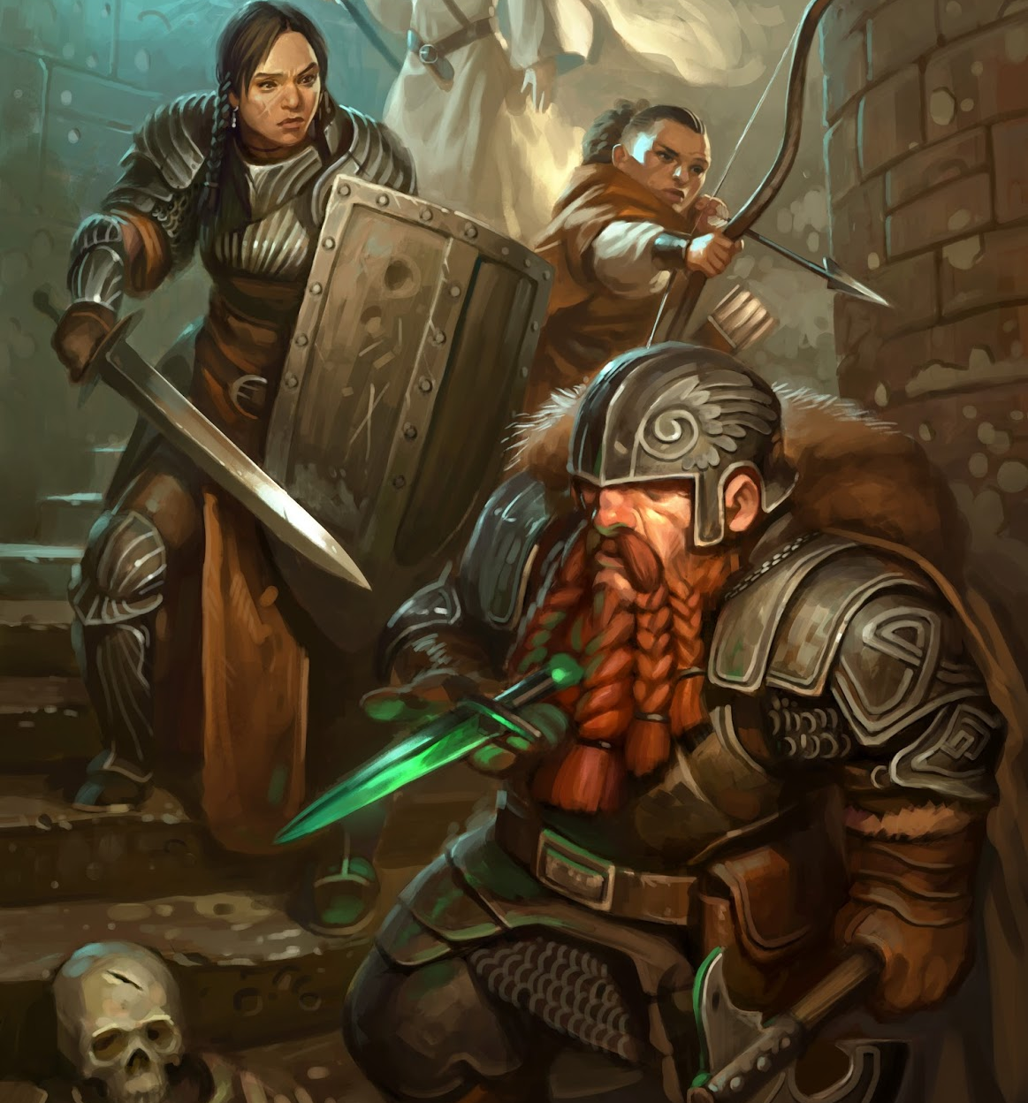
What Problem Does This Solve?
Playing Dungeons & Dragons with friends is a ton of fun!
Preparing the game to be played can become a hassle
Outline potential scenes and encounters
Copy monster statistics
Prepare random encounters
Create meaningful Non player characters
There is no guarantee that you will use all you’ve prepared!
The goal of this project is to solve this problem by streamlining the process of preparing a game and help focus on what matters.

Slide 3
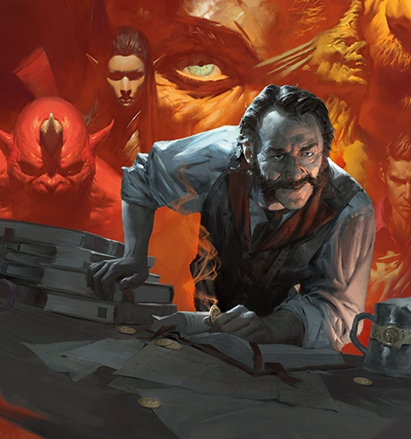
What Is Adventure Day?
Removes busy work of creating and documenting a D&D Adventure while preserving creativity.
Fetches monster statistics from a Database for easy reference during sessions.
Assists in scaling monster difficulties to fit all levels of Adventuring Parties.
Generates encounters with specific monsters or any monsters from a specified environment.
Generates role playing traits for Non-Player Characters from a list quirks and behaviors.
Formats Story Outline, Monsters and NPCs into a cohesive markdown output for use with the Homebrewery website.

Slide 4

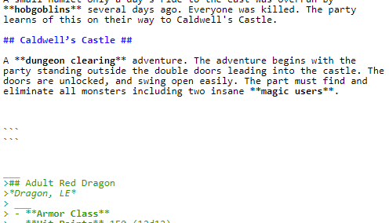
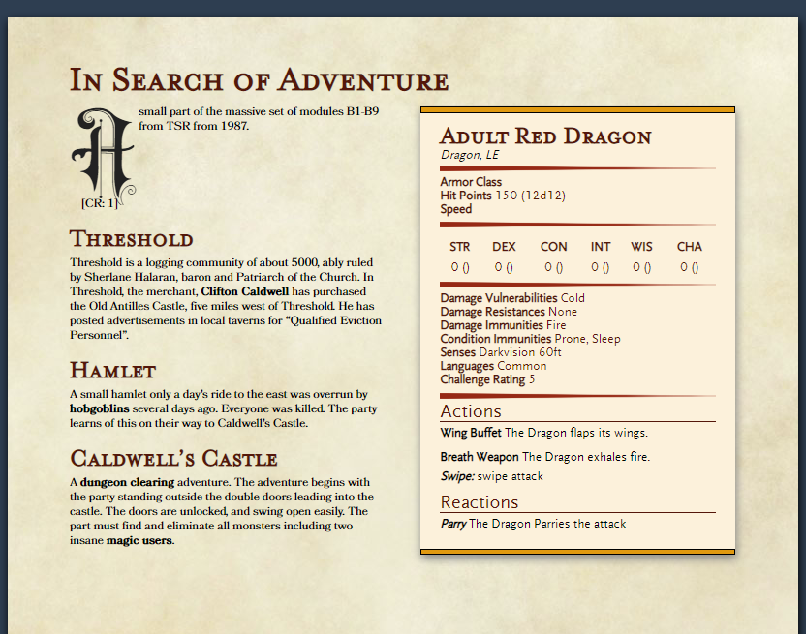
Behind the Dungeon Master Screen
Postgres as a Backend Database to Contain Monsters
Hit points, Attacks, Abilities, Actions, environments
Intersect tables to tie many abilities to many monsters
Text parser in Python created for processing story ideas
Accepts a text file in markdown format with an optional annotated dictionary for additional modifications to data.
Identifies highlighted terms in text and processes dictionary items for further processing
Algorithms for Monster Selection and Querying.
Queries for selecting monsters based on environments and abilities
Constructs monster encounters based on difficulty ranges
Scales monster statistics (AC, HP, abilities, etc…) based on D&D rules
Text formatting to Markdown using Python libraries
Formats Story, NPC’s, and Monsters into a readable format using The Home brewery's formatting rules to read like an actual D&D book.

